Slide 1

RV College of
Engineering®
Go, change the world
Department of Mechanical Engineering
RV College of Engineering®, Bengaluru – 560 059
ELEMENTS OF MECHANICAL ENGINEERING
UNIT- V
Mechatronics & Robotics
Dr. Prapul chandra AC, Asst. Prof., Department of Mechanical Engineering, RV College of Engineering

Slide 2
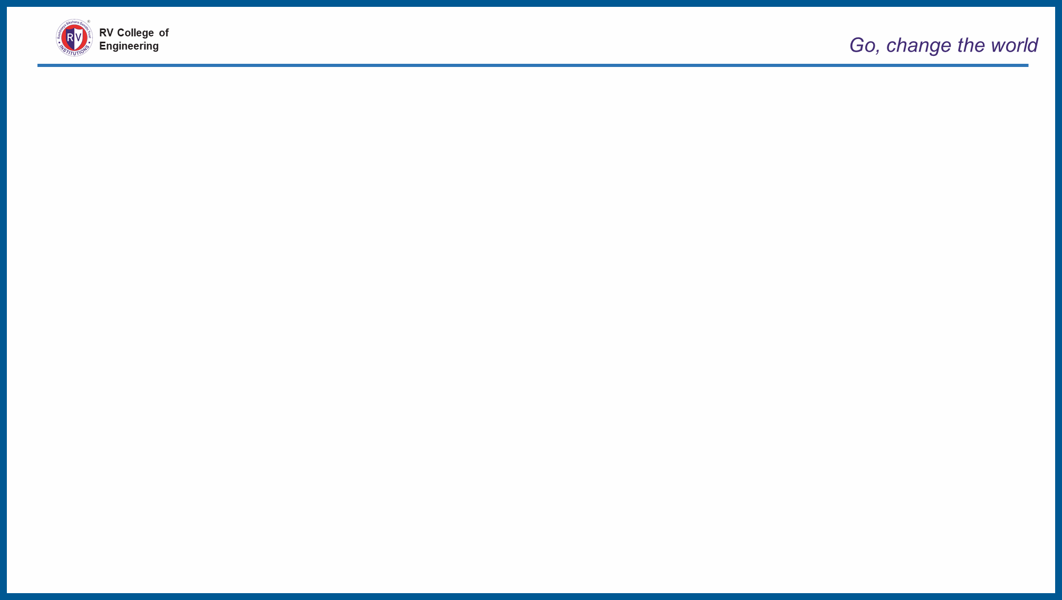
UNIT- V (05 hours)
Introduction: Evolution of Mechatronic system, measurement & control system, basic elements of control system, Applications-water level controller, washing machine, Engine management system (EMS), Anti-lock Braking System (ABS).
Robotics:
Robots- Basic Structure of Robots, Robot Anatomy, Complete Classification of Robots, Fundamentals about Robot Technology, Basic Robot Configurations and their Relative Merits and Demerits.
UNIT 5 - Mechatronics
Dr. Prapul chandra AC, Asst. Prof., Department of Mechanical Engineering, RV College of Engineering

Slide 3
UNIT 5 - Mechatronics
INTRODUCTION
The term “Mechatronics “ was coined in 1969 by a senior engineer of a Japanese Yasakawa Electric Company to refer to the use of electronics in mechanical control.
Mechatronics is defined as the synergistic integration of mechanical engineering with electronics and intelligent computer control in the design and manufacturing of products and process
Dr. Prapul chandra AC, Asst. Prof., Department of Mechanical Engineering, RV College of Engineering

Slide 4

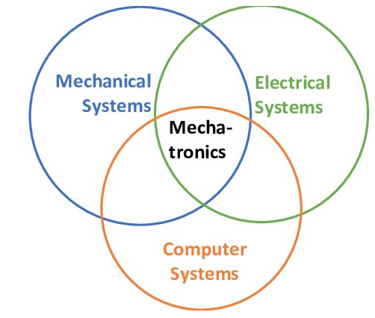
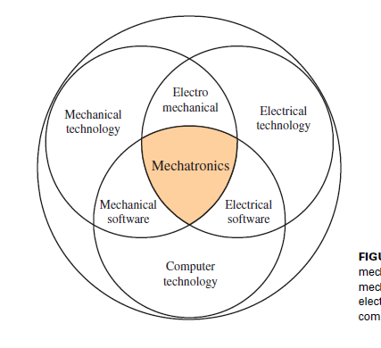
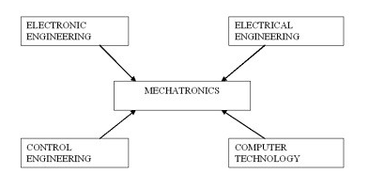
UNIT 5 - Mechatronics
RV College of
Engineering
Go, change the world
Domain of Mechatronics
Dr. Prapul chandra AC, Asst. Prof., Department of Mechanical Engineering, RV College of Engineering

Slide 5
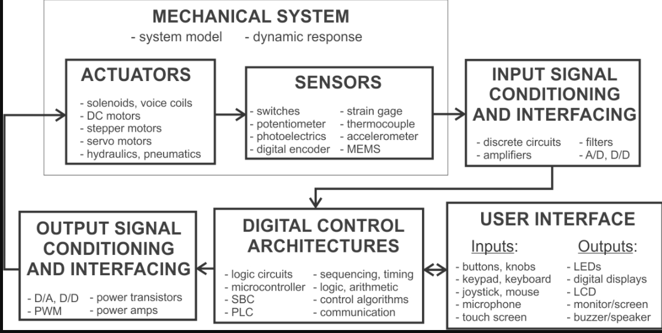
UNIT 5 - Mechatronics
RV College of
Engineering
Go, change the world
Key elements of Mechatronics systems
https://youtu.be/Ro_tFv1iH6g
Dr. Prapul chandra AC, Asst. Prof., Department of Mechanical Engineering, RV College of Engineering

Slide 6
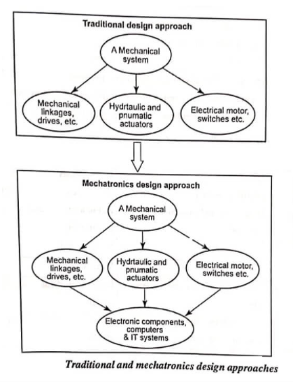
UNIT 5 - Mechatronics
RV College of
Engineering
Go, change the world
Mechatronics design process
Dr. Prapul chandra AC, Asst. Prof., Department of Mechanical Engineering, RV College of Engineering

Slide 7
UNIT 5 - Mechatronics
RV College of
Engineering
Go, change the world
Phase of Mechatronic system design process
Modelling & Simulation
Prototyping
Deployment
Dr. Prapul chandra AC, Asst. Prof., Department of Mechanical Engineering, RV College of Engineering

Slide 8
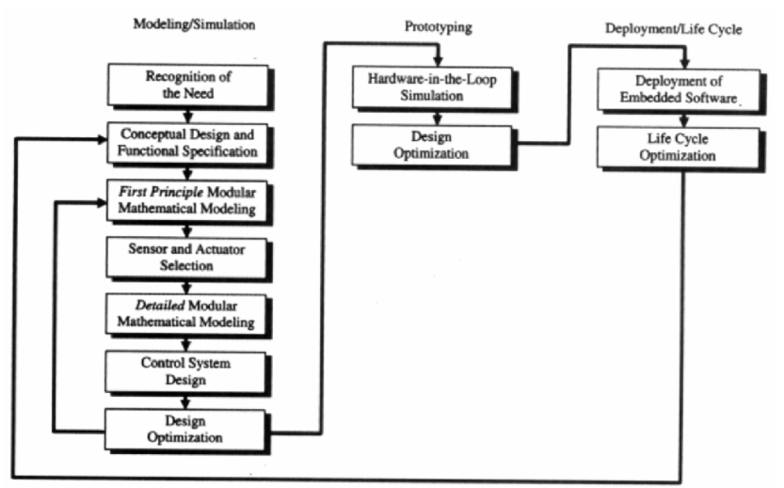
UNIT 5 - Mechatronics
RV College of
Engineering
Go, change the world
Phase of Mechatronic system design process
Dr. Prapul chandra AC, Asst. Prof., Department of Mechanical Engineering, RV College of Engineering

Slide 9
Impulse Water turbine
UNIT 5 - Mechatronics
RV College of
Engineering
Go, change the world
COMPARISON OF TRADITIONAL AND MECHATRONIC DESIGN
TRADITIONAL | MECHATRONICS
Sequential approach | Concurrent approach
Process controlled by relay logic | Microprocessor based programmable logic controller
More wiring to control computer and control room | Reduced wiring and machine cycles stored and executed via local control loops
Manual handling processes for loading and unloading | Use of general purpose robotic for handling; automatic tool changing
Maintenance on a preventive or breakdown basis | Based on in – line diagnostics and condition monitoring
Dr. Prapul chandra AC, Asst. Prof., Department of Mechanical Engineering, RV College of Engineering

Slide 10
UNIT 5 - Mechatronics
RV College of
Engineering
Go, change the world
CONTROL SYSTEM
A control system can be thought of as a system which for some particular input or inputs is used to control its output to some particular value, give a particular sequence of events or give an event if certain conditions are met.
Example:
      Central heating system
      Domestic washing machine
      Safety lock system
Two basic forms of control systems are open loop and closed loop.
Dr. Prapul chandra AC, Asst. Prof., Department of Mechanical Engineering, RV College of Engineering

Slide 11

PELTON WHEEL
UNIT 5 - Mechatronics
RV College of
Engineering
Go, change the world
OPEN LOOP CONTROL SYSTEM
Basic elements of an open loop control system are:
    Control element
    Correction element
    Process
Example: Automatic toaster system
Dr. Prapul chandra AC, Asst. Prof., Department of Mechanical Engineering, RV College of Engineering

Slide 12
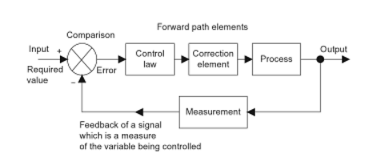
PELTON WHEEL
UNIT 5 - Mechatronics
RV College of
Engineering
Go, change the world
CLOSED LOOP CONTROL SYSTEM
  Basic elements of a closed loop control system are:
      Comparison element
      Control law
      Correction element
      Process
      Measurement element
  Example: Automatic water level control, Central heating control
Dr. Prapul chandra AC, Asst. Prof., Department of Mechanical Engineering, RV College of Engineering

Slide 13
PELTON WHEEL
UNIT 5 - Mechatronics
RV College of
Engineering
Go, change the world
CONTROL SYSTEM OF A MECHATRONIC SYSTEM
The control system for a mechatronic system can be classified as either a discrete event control system or a feedback control system.
In discrete event system, the controller controls the execution of a sequence of events.
In a feedback control system, the controller controls one or more variables using feedback sensors and feedback control laws.
Example: Automatic washing machine,Automatic camera.
Dr. Prapul chandra AC, Asst. Prof., Department of Mechanical Engineering, RV College of Engineering

Slide 14
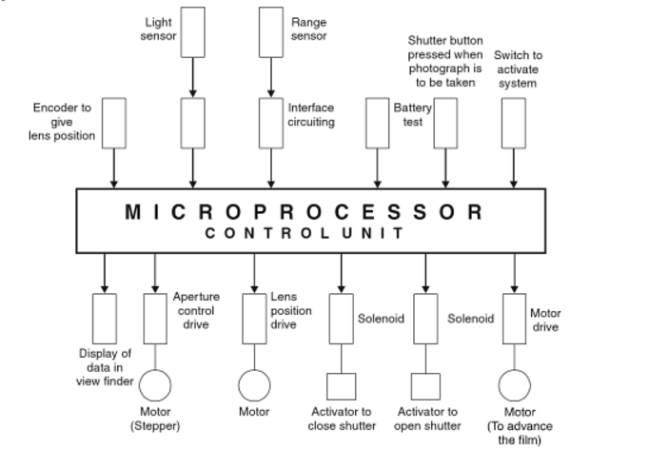
PELTON WHEEL
UNIT 5 - Mechatronics
RV College of
Engineering
Go, change the world
AUTOMATIC CAMERA
Dr. Prapul chandra AC, Asst. Prof., Department of Mechanical Engineering, RV College of Engineering

Slide 15
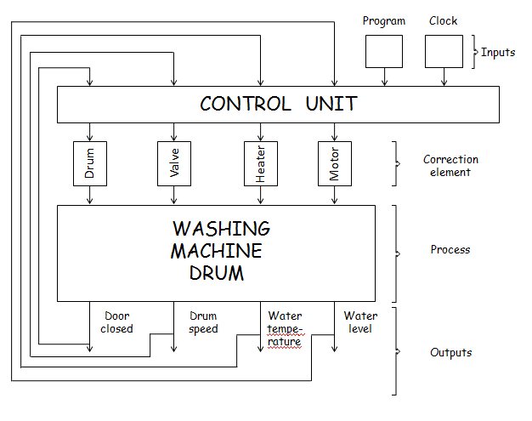
PELTON WHEEL
UNIT 5 - Mechatronics
RV College of
Engineering
Go, change the world
AUTOMATIC WASHING MACHINE
Dr. Prapul chandra AC, Asst. Prof., Department of Mechanical Engineering, RV College of Engineering

Slide 16
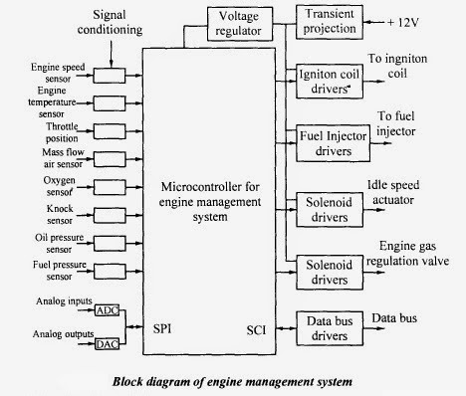
PELTON WHEEL
UNIT 5 - Mechatronics
RV College of
Engineering
Go, change the world
ENGINE MANAGEMENT SYSTEM
Dr. Prapul chandra AC, Asst. Prof., Department of Mechanical Engineering, RV College of Engineering

Slide 17
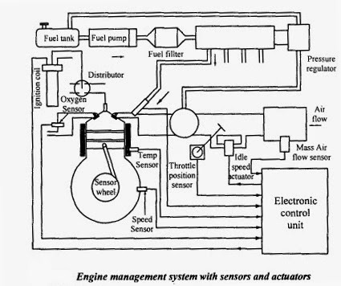
PELTON WHEEL
UNIT 5 - Mechatronics
RV College of
Engineering
Go, change the world
ENGINE MANAGEMENT SYSTEM
Dr. Prapul chandra AC, Asst. Prof., Department of Mechanical Engineering, RV College of Engineering

Slide 18
UNIT III – Automation in Manufacturing
RV College of
Engineering
Go, change the world
ROBOT:
The word robot was first coined by Czech novelist KAREL CAPEK in 1920’s. The word robot means a servant or a worker. However, this was just a word coined but the actual technological development in the field of robot was first noted in the year 1957 by English inventor CYRIL WALTER KENWARD developed a manipulator that could move in x-y-z axes system.
Dr. Prapul chandra AC, Asst. Prof., Department of Mechanical Engineering, RV College of Engineering

Slide 19
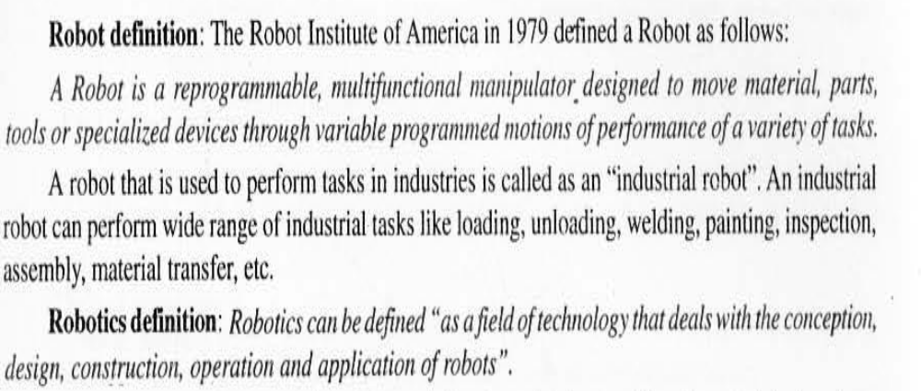
UNIT III – Automation in Manufacturing
RV College of
Engineering
Go, change the world
Dr. Prapul chandra AC, Asst. Prof., Department of Mechanical Engineering, RV College of Engineering

Slide 20
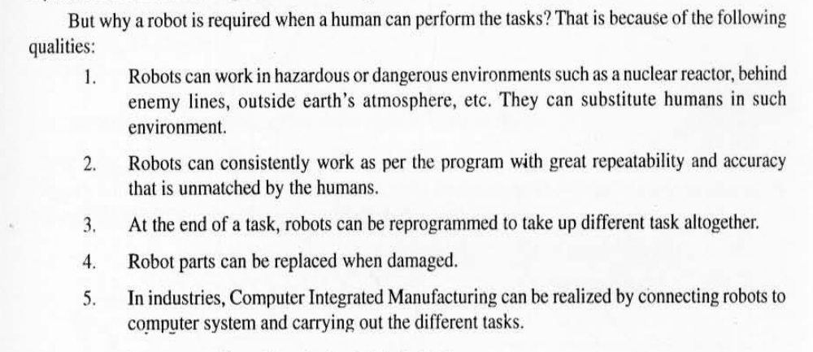
UNIT III – Automation in Manufacturing
RV College of
Engineering
Go, change the world
Dr. Prapul chandra AC, Asst. Prof., Department of Mechanical Engineering, RV College of Engineering

Slide 21
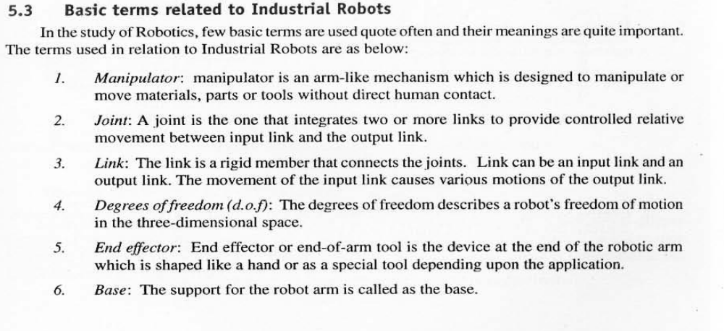
UNIT III – Automation in Manufacturing
RV College of
Engineering
Go, change the world
Dr. Prapul chandra AC, Asst. Prof., Department of Mechanical Engineering, RV College of Engineering

Slide 22
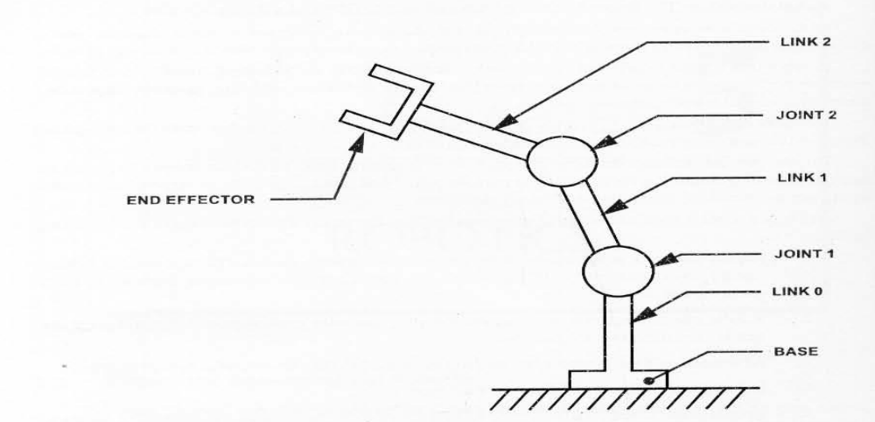
UNIT III – Automation in Manufacturing
RV College of
Engineering
Go, change the world
Dr. Prapul chandra AC, Asst. Prof., Department of Mechanical Engineering, RV College of Engineering

Slide 23
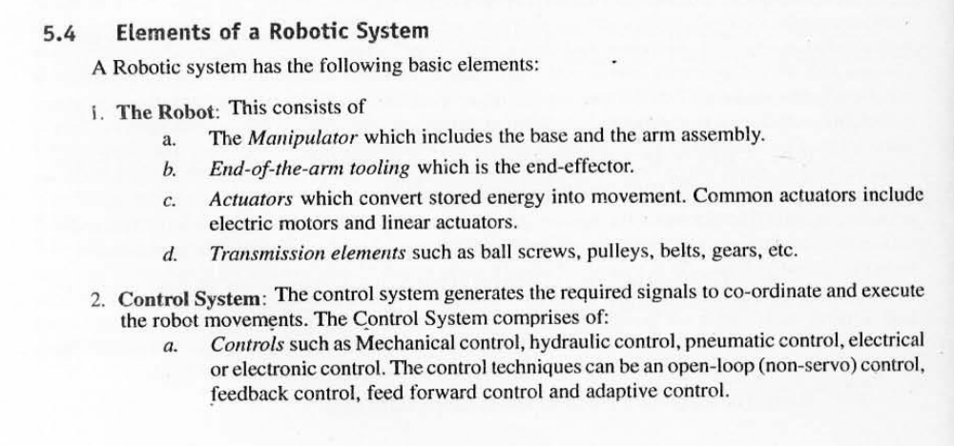
UNIT III – Automation in Manufacturing
RV College of
Engineering
Go, change the world
Dr. Prapul chandra AC, Asst. Prof., Department of Mechanical Engineering, RV College of Engineering

Slide 24
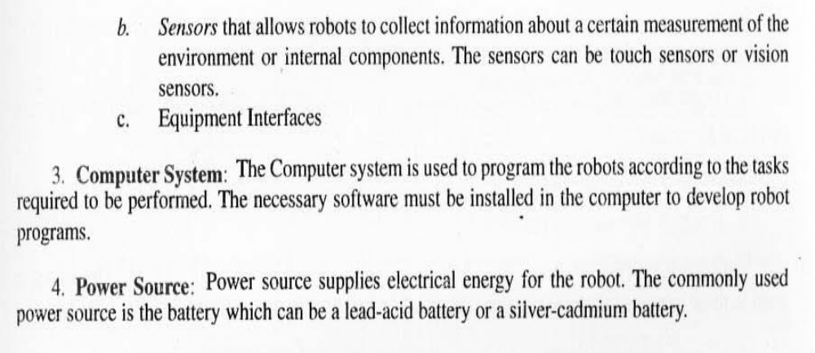
UNIT III – Automation in Manufacturing
RV College of
Engineering
Go, change the world
Dr. Prapul chandra AC, Asst. Prof., Department of Mechanical Engineering, RV College of Engineering

Slide 25
UNIT III – Automation in Manufacturing
RV College of
Engineering
Go, change the world
Classification of Robot based on Robot configuration:
Polar configuration
Cylindrical configuration
Cartesian configuration
Joint arm configuration
Dr. Prapul chandra AC, Asst. Prof., Department of Mechanical Engineering, RV College of Engineering

Slide 26
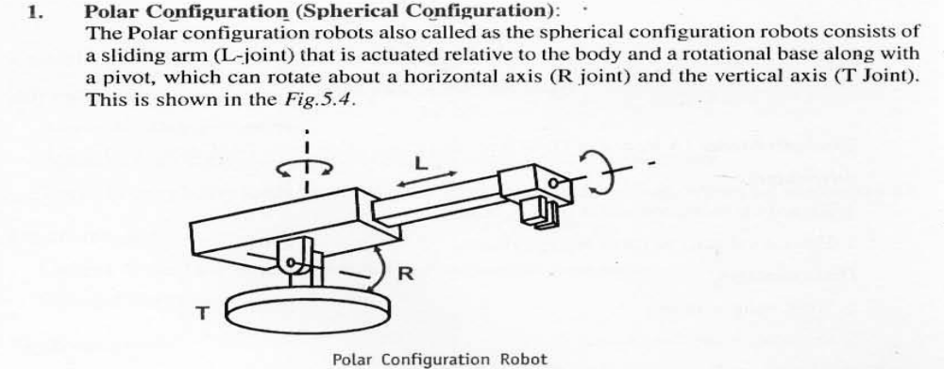
UNIT III – Automation in Manufacturing
RV College of
Engineering
Go, change the world
Dr. Prapul chandra AC, Asst. Prof., Department of Mechanical Engineering, RV College of Engineering

Slide 27
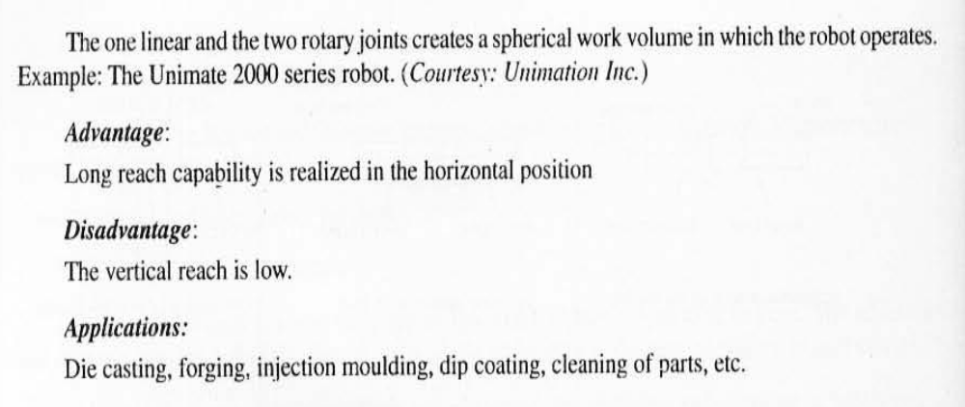
UNIT III – Automation in Manufacturing
RV College of
Engineering
Go, change the world
Dr. Prapul chandra AC, Asst. Prof., Department of Mechanical Engineering, RV College of Engineering

Slide 28
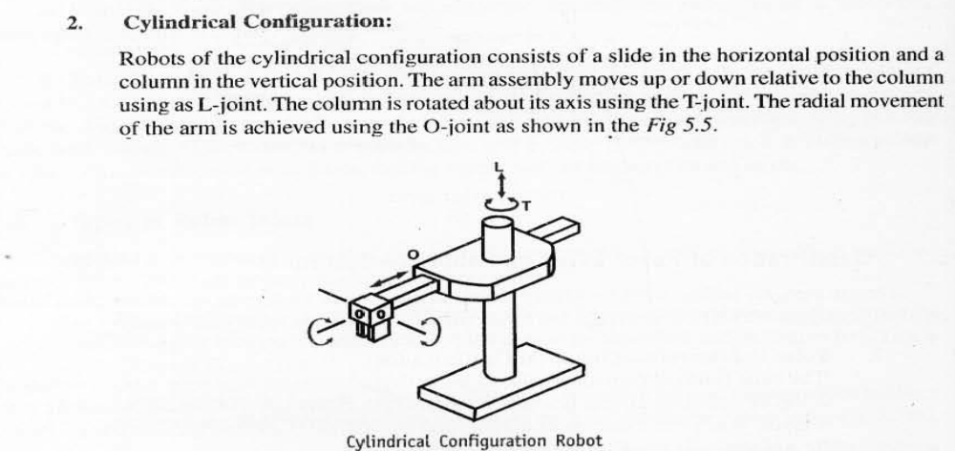
UNIT III – Automation in Manufacturing
RV College of
Engineering
Go, change the world
Dr. Prapul chandra AC, Asst. Prof., Department of Mechanical Engineering, RV College of Engineering

Slide 29
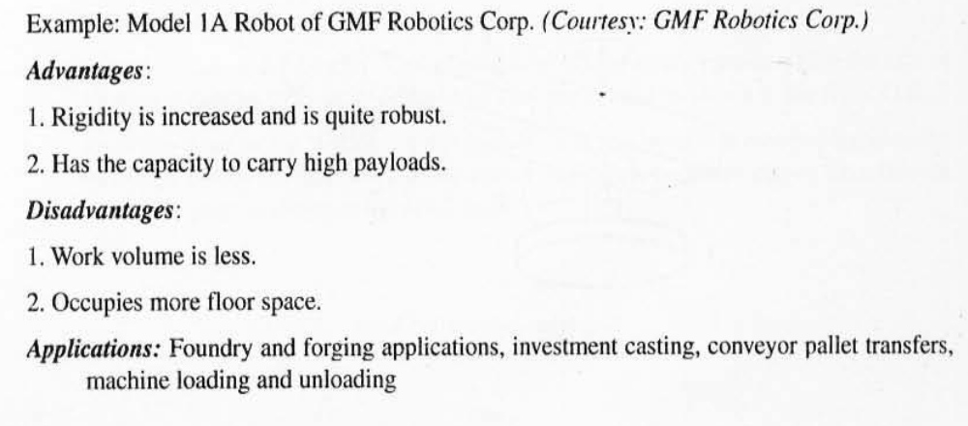
UNIT III – Automation in Manufacturing
RV College of
Engineering
Go, change the world
Dr. Prapul chandra AC, Asst. Prof., Department of Mechanical Engineering, RV College of Engineering

Slide 30
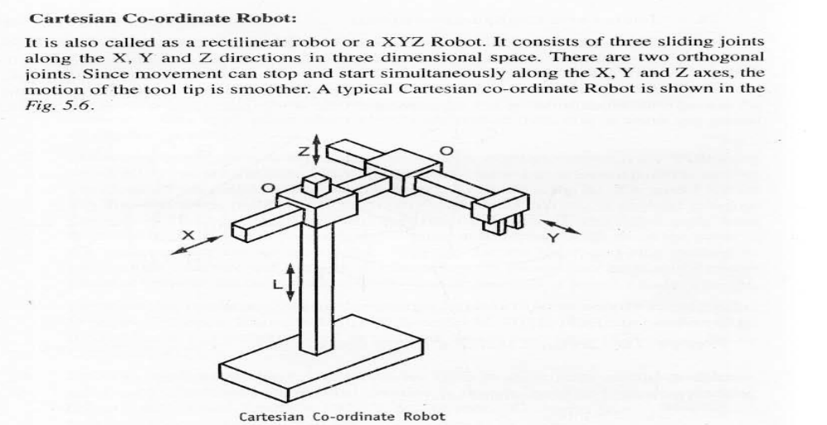
UNIT III – Automation in Manufacturing
RV College of
Engineering
Go, change the world
Dr. Prapul chandra AC, Asst. Prof., Department of Mechanical Engineering, RV College of Engineering

Slide 31
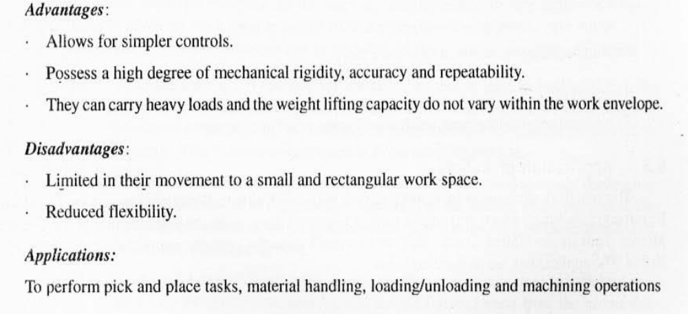
UNIT III – Automation in Manufacturing
RV College of
Engineering
Go, change the world
Dr. Prapul chandra AC, Asst. Prof., Department of Mechanical Engineering, RV College of Engineering

Slide 32
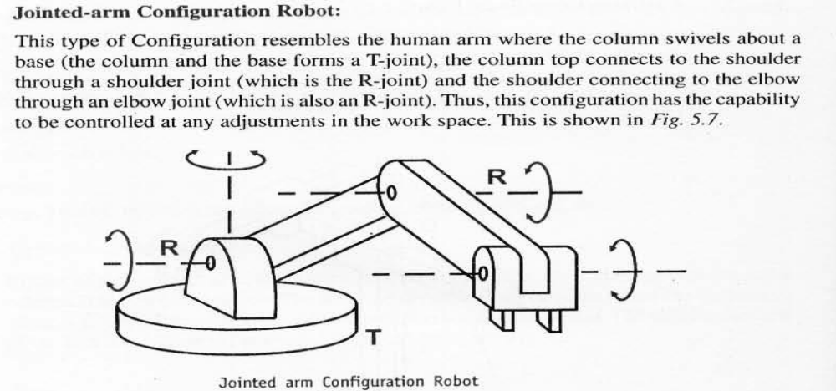
UNIT III – Automation in Manufacturing
RV College of
Engineering
Go, change the world
Dr. Prapul chandra AC, Asst. Prof., Department of Mechanical Engineering, RV College of Engineering

Slide 33
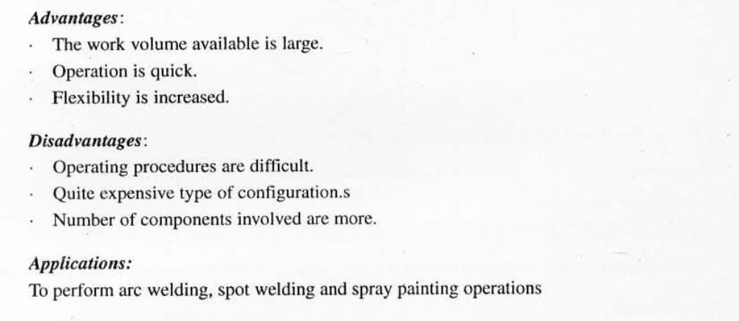
UNIT III – Automation in Manufacturing
RV College of
Engineering
Go, change the world
Dr. Prapul chandra AC, Asst. Prof., Department of Mechanical Engineering, RV College of Engineering

Slide 34
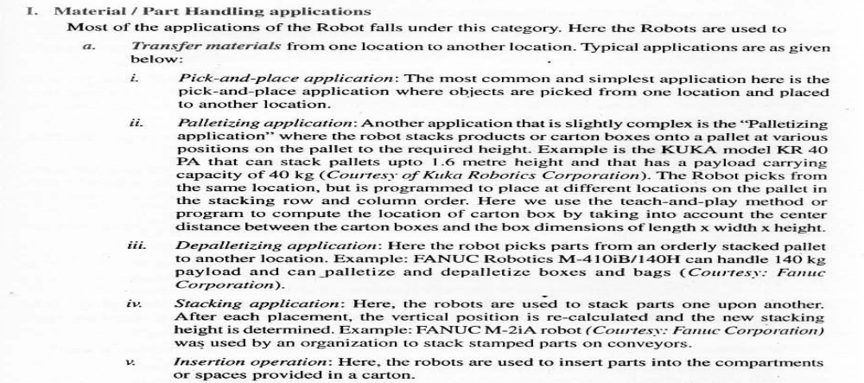
UNIT III – Automation in Manufacturing
RV College of
Engineering
Go, change the world
Applications of Robot
Dr. Prapul chandra AC, Asst. Prof., Department of Mechanical Engineering, RV College of Engineering

Slide 35
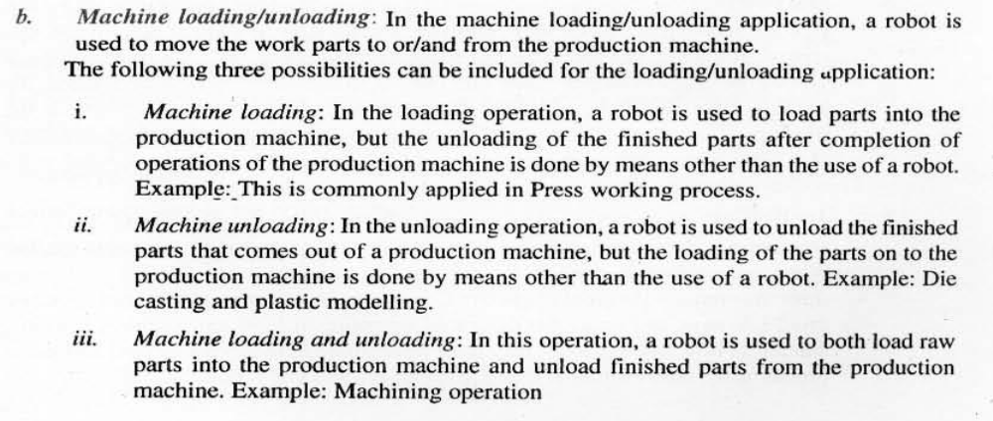
UNIT III – Automation in Manufacturing
RV College of
Engineering
Go, change the world
Applications of Robot
Dr. Prapul chandra AC, Asst. Prof., Department of Mechanical Engineering, RV College of Engineering

Slide 36
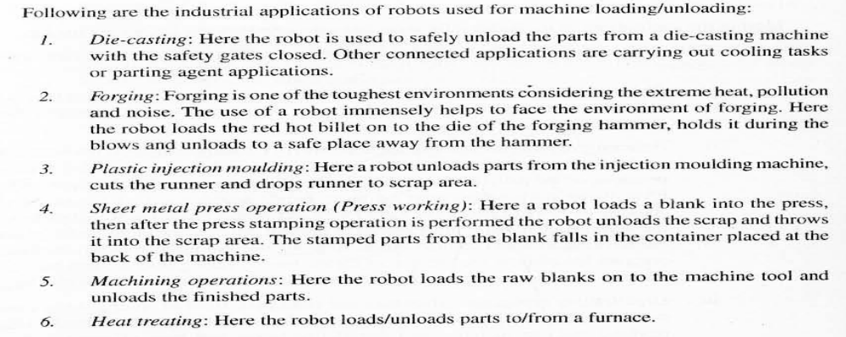
UNIT III – Automation in Manufacturing
RV College of
Engineering
Go, change the world
Applications of Robot
Dr. Prapul chandra AC, Asst. Prof., Department of Mechanical Engineering, RV College of Engineering

Slide 37
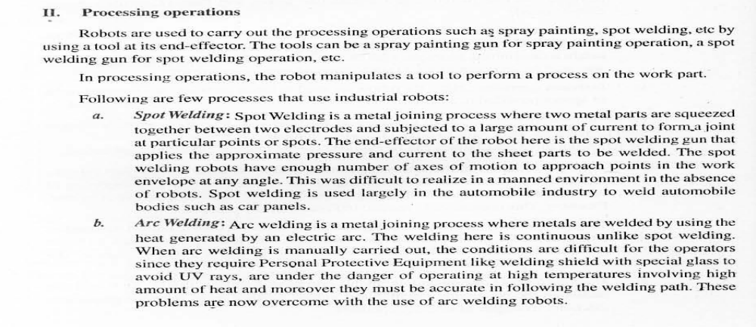
UNIT III – Automation in Manufacturing
RV College of
Engineering
Go, change the world
Applications of Robot
Dr. Prapul chandra AC, Asst. Prof., Department of Mechanical Engineering, RV College of Engineering

Slide 38
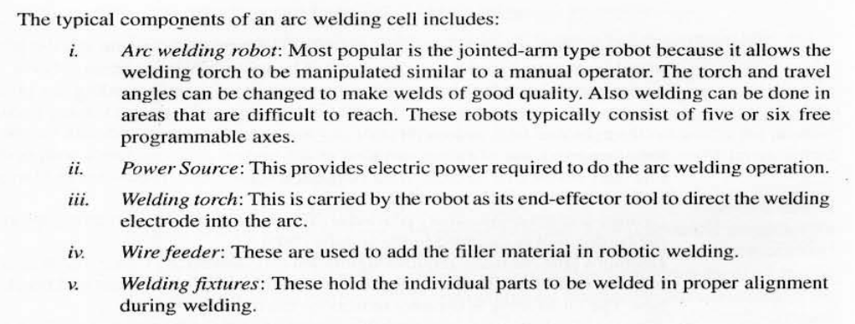
UNIT III – Automation in Manufacturing
RV College of
Engineering
Go, change the world
Applications of Robot
Dr. Prapul chandra AC, Asst. Prof., Department of Mechanical Engineering, RV College of Engineering

Slide 39
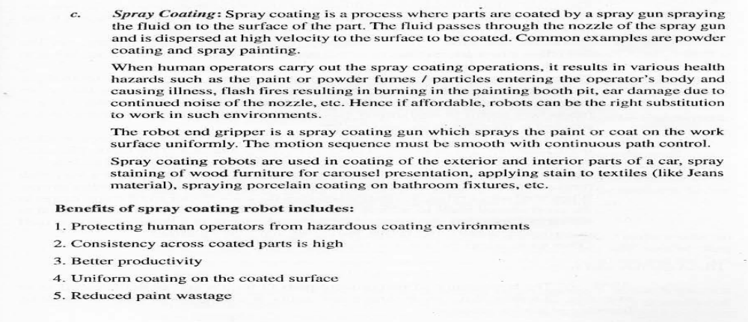
UNIT III – Automation in Manufacturing
RV College of
Engineering
Go, change the world
Applications of Robot
Dr. Prapul chandra AC, Asst. Prof., Department of Mechanical Engineering, RV College of Engineering

Slide 40
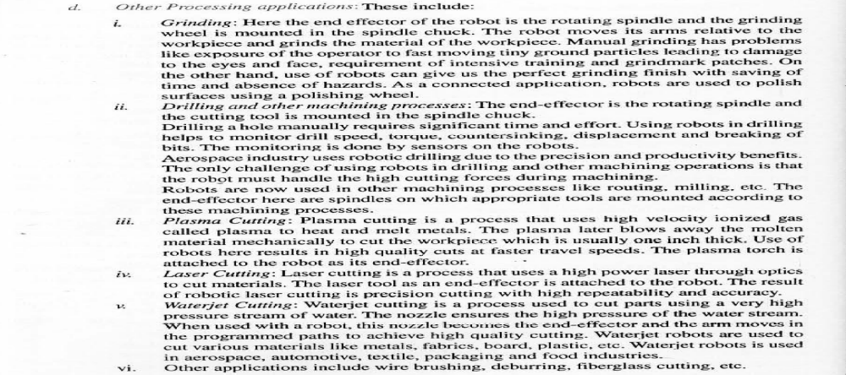
UNIT III – Automation in Manufacturing
RV College of
Engineering
Go, change the world
Applications of Robot
Dr. Prapul chandra AC, Asst. Prof., Department of Mechanical Engineering, RV College of Engineering

Slide 41
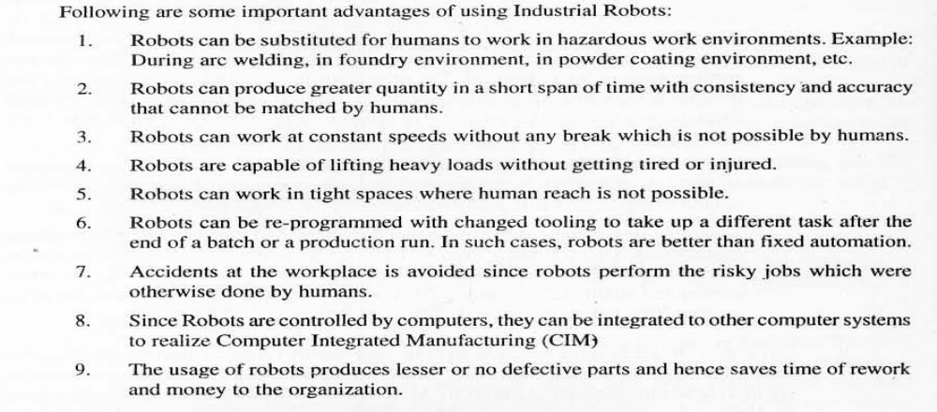
UNIT III – Automation in Manufacturing
RV College of
Engineering
Go, change the world
Advantages of Robot
Dr. Prapul chandra AC, Asst. Prof., Department of Mechanical Engineering, RV College of Engineering

Slide 42
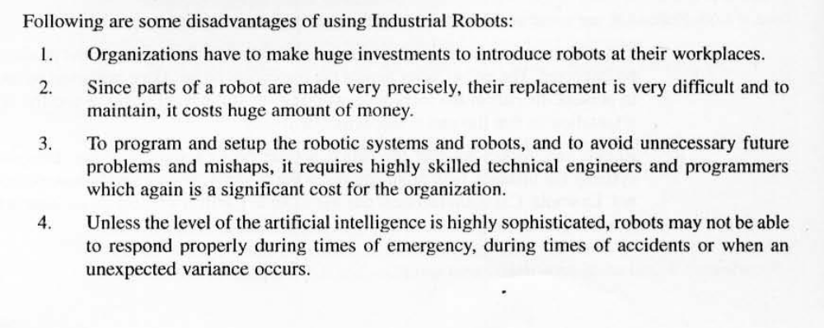
UNIT III – Automation in Manufacturing
RV College of
Engineering
Go, change the world
Dis-Advantages of Robot
Dr. Prapul chandra AC, Asst. Prof., Department of Mechanical Engineering, RV College of Engineering

